Slide 1
Digital Dream Team
| Keith Camp | Mohammed Al Madhi | Joseph Baxter | Kyle Cousin | Eric Lopez | Matthew Smith |

Slide 2
Agenda
Problems and Proposed Solutions
Overview of the whole system
System Functionality
System Features
Summary
Questions

Slide 3
PROBLEM and solution
The Office of Research and Innovation is Running and operating on a system with limited capabilities that lacks its ease of use, which is negatively impacting the organization’s Business Process.
Non-friendly User-Interface (UI)
Current website include outdated information such as events, news & announcements and the videos embed on the website
Example: https://louisville.edu/research/announcements
Web Design
Tabs include redundant information.
Statistics
Displaying statistical report and research spending's on the landing page could potentially attract researchers and industries.
Information Overload
Navigation menus are overloaded with information which creates frustration when looking for an information.

Slide 4
Problem and solution cont.
Our proposed solution is to renovate the website using WordPress while maintaining the organization goals of the R&I department as well as the University’s as a whole.
WordPress decreases the amount of time needed to edit and add content to site.
Changes on the site will be explained accurately to the staff so they can transition easily into the new system.

Slide 5
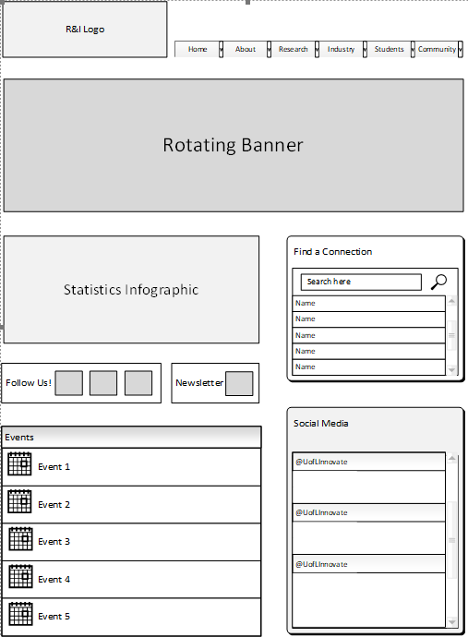
Website’s imagined landing page using wireframe
Overview of the functionality of the website

Slide 6
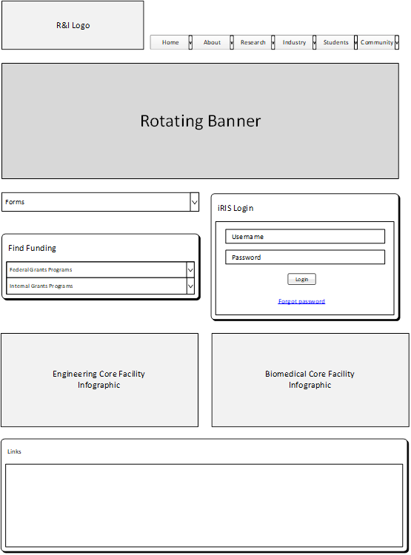
Research landing page
Overview of the functionality of the website

Slide 7
Industry’s landing page
Overview of the functionality of the website

Slide 8
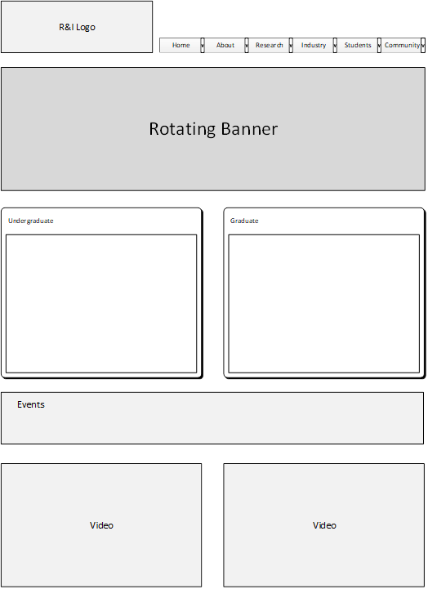
Overview of the functionality of the website
STUDENT’S LANDING PAGE

Slide 9
Overview of the functionality of the website
COMMUNITY LANDING PAGE

Slide 10
Overview of the functionality of the website
This is the website we have built for DEMO I
www.DigitalDreamTeam.xyz

Slide 11
SYSTEM FEATURES
Our website is built using WordPress.
Appointment Red is the Theme of our website.
Beaver Plugin – helps us with the website design.
Events Calendar Plugin – helps us Create/Edit and Post events to our website.
WPForm – Assists us with creating a contact us form that was implemented on our About us page.
Our Hosting site is www.sharkhosting.co.uk it is reliable cheap hosting which offers us unlimited bandwidth, unlimited SSD Disk space which allows our website to load much faster.

Slide 12
Summary
The Research and Innovation website suffers from several key issues in its current form​
Our goal?
To provide the client with a solution-system!​
Increase attracts potential industries which could increase grants.
Lastly renovating the website using which allows it ease of use to our students and staff.

